Slide 1


Slide 2


PORTO POLYTECHNIC PRESENTATION
WELCOME TO P.PORTO
P. PORTO is a referential public higher education institution. Beginning its activity in 1985, it’s today the fourth largest institution of higher education in terms of access. We are a dynamo of cultural change, both nationally and internationally. We meet current demands, building bridges between academia, the professional world and civil society.
We build strategic cooperation with local agents, and contribute with real solutions to real problems.
We rank fourth among first-choice higher education institutions, and fifth in number
of students.
18.322
Students
59
Undergraduate Degrees
70
Master
Degrees

Slide 3
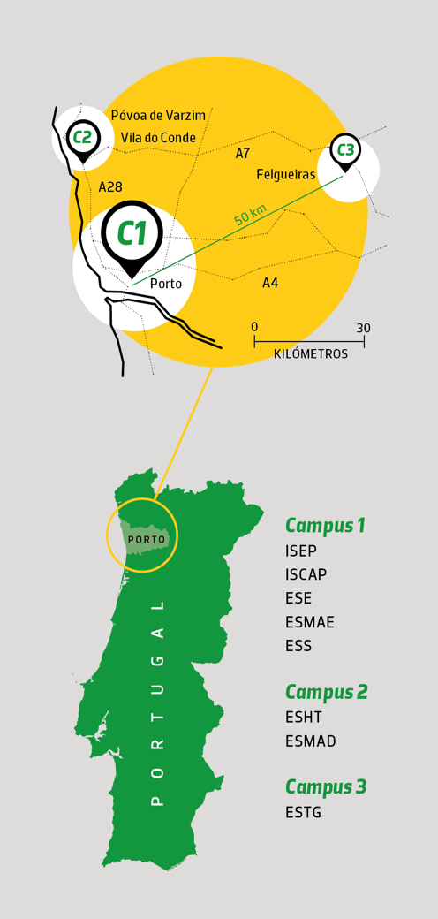
PORTO POLYTECHNIC CAMPI
CAMPI
At Campus 1, between downtown Porto and the mainly technological and innovative area of Asprela (north of the county), P.PORTO students can enjoy the perks of both innovative and technological learning venues and a bustling, increasingly cosmopolitan city.
Campus 2 is located between the towns of Vila do Conde and Póvoa de Varzim.
Felgueiras is home to Campus 3, where we can find the School of Management and Technology.
Politécnico do Porto is spread across an extensive and diversified area.
5
Cities
3
Campi
8
Schools

Slide 4

PORTO POLYTECHNIC SCHOOLS
SCHOOLS
An educational complex with modern equipment, laboratories and research centres located in 3 Campi that fosters a high quality and varied educational offer based in seven core clusters.
Arts
Business Sciences
Education & Sport
Engineering & Technology
Hospitality and Tourism
Media and Design
Health

Slide 5
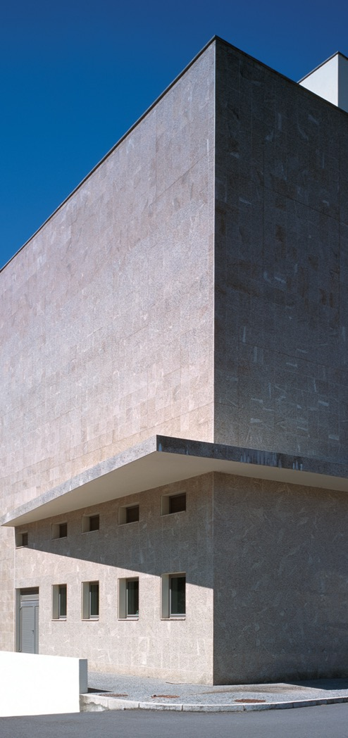
PORTO POLYTECHNIC PORTO SCHOOL OF ENGINEERING
PORTO SCHOOL OF ENGINEERING
Since 1852, Instituto Superior de Engenharia do Porto has become a successful trademark in the education and innovation of Engineering, preserving its commitment to the future. Anchored in an applied knowledge-based educational model (hands-on), ISEP follows the international best practices in European quality certification, favoring the development of academic projects in businesses and research groups.
One of the top schools of technology in Portugal, ISEP is also the engineering school with more certified programmes in all Iberian Peninsula.
A RUA DR. BERNARDINO DE ALMEIDA, 431
4249-015 PORTO, PORTUGAL
T 228 340 500 F 228 321 159
E MAIL@ISEP.IPP.PT W ISEP.IPP.PT
6.461
Students
437
Teaching Staff

Slide 6
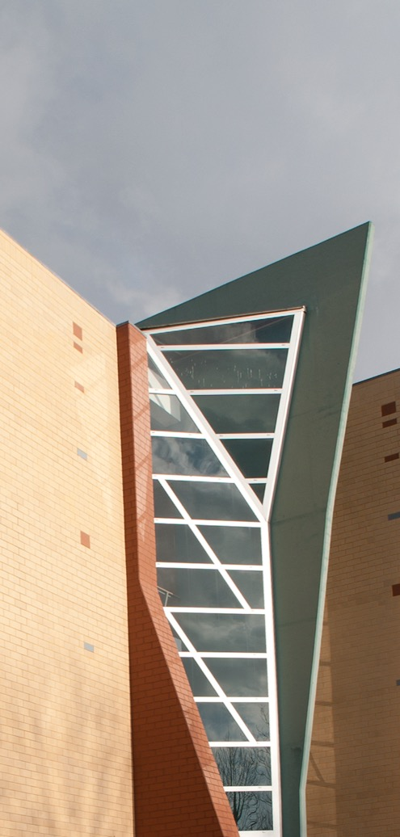
PORTO POLYTECHNIC PORTO ACCOUNTING AND BUSINESS SCHOOL
PORTO ACCOUNTING AND BUSINESS SCHOOL
With a long history of training in the field of business sciences, the Instituto Superior de Contabilidade e Administração do Porto has, since 1886, implemented a higher education model of excellence, strongly concerned with creating an interface between the academy and its surrounding community.
ISCAP continually strives to provide a stimulating environment in Business Sciences.
A RUA JAIME LOPES AMORIM, S/N
4465-004 SÃO MAMEDE DE INFESTA, PORTUGAL
T 229 050 000 F 229 025 899
E INSTITUTO@ISCAP.IPP.PT W ISCAP.IPP.PT
4.258
Students
256
Teaching Staff

Slide 7

PORTO POLYTECHNIC SCHOOL OF EDUCATION
SCHOOL OF EDUCATION
The Escola Superior de Educação has the stronghold of teacher training, but also of the training of educators, and social and cultural players in numerous areas - from languages to music, to sports.
ESE is a school where education, culture, sports and citizenship converge in a single space of training and knowledge.
A RUA DR. ROBERTO FRIAS, 602
4200-465 PORTO, PORTUGAL
T 225 073 460 F 225 073 464
E ESE@ESE.IPP.PT W ESE.IPP.PT
1.883 Students
161
Teaching Staff

Slide 8
PORTO POLYTECHNIC SCHOOL OF MUSIC AND PERFORMING ARTS
SCHOOL OF MUSIC AND PERFORMING ARTS
Built in 1985, on the foundations of the former School of Music, the Escola Superior de Música e Artes do Espetáculo is one of the founding schools of the Porto Polytechnic.
Located in the centre of Porto, ESMAE has na international standing, and offer customised and cutting-edge higher education programmes in music and drama.
A RUA DA ALEGRIA, 503
4000-045 PORTO, PORTUGAL
T 225 193 760
E ESMAE@ESMAE.IPP.PT W ESMAE.IPP.PT
709
Students
126
Teaching Staff

Slide 9

PORTO POLYTECHNIC SCHOOL OF MANAGEMENT AND TECHNOLOGY
SCHOOL OF MANAGEMENT AND TECHNOLOGY
Escola Superior de Tecnologia e Gestão, located in the region of Vale do Sousa e Baixo Tâmega, the School of Management and Technology has established itself, since 1999, as a leader in academic and industry collaboration.
This school articulates higher education with the business world and is always focused on students' employability and meeting regional needs.
A RUA DO CURRAL, CASA DO CURRAL, MARGARIDE
4610-156 FELGUEIRAS, PORTUGAL
T 225 314 002 F 225 314 12O
E CORREIO@ESTG.IPP.PT W ESTG.IPP.PT
1.434
Students
131
Teaching Staff

Slide 10
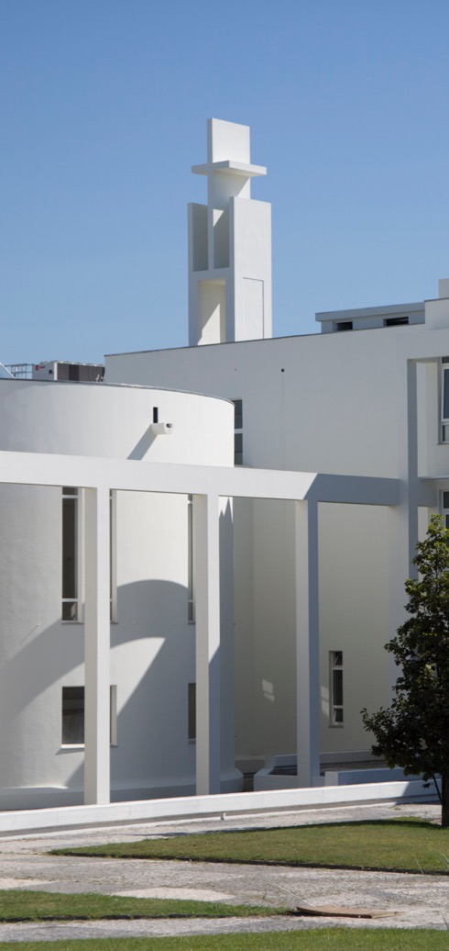
PORTO POLYTECHNIC SCHOOL OF HEALTH
SCHOOL OF HEALTH
Escola Superior de Saúde is the largest Portuguese higher education institution in the area of healthcare technologies. With its 2,445 students, 275 teaching staff members, 12 undergraduate degrees, seven masters’ degrees and several continuing education courses, the School is the third biggest in P.PORTO.
The most recent addition to one of Europe’s strongest health and science hubs, ESS leads the way in Health Technology Education.
A RUA DR. ANTÓNIO BERNARDINO DE ALMEIDA, 400
4200-072 PORTO, PORTUGAL
T 222 061 000 F 222 061 001
E GERAL@ESS.IPP.PT W ESS.IPP.PT
2.415
Students
298
Teaching Staff

Slide 11
PORTO POLYTECHNIC SCHOOL OF HOSPITALITY AND TOURISM
SCHOOL OF HOSPITALITY AND TOURISM
As a centre of excellence in teaching and research, the Escola Superior de Hotelaria e Turismo is placed at the top of mind of the market, providing a sustainable and innovative training model.
We develop selected strategies, not only for teaching and research but also for services provision, relationship with the community, establishing networks and partnerships and internationalisation.
A RUA D. SANCHO I, 981
4480-876 VILA DO CONDE, PORTUGAL
T 252 291 700 F 252 291 714
E GERAL@ESHT.IPP.PT W ESHT.IPP.PT
664
Students
47
Teaching Staff

Slide 12

PORTO POLYTECHNIC SCHOOL OF MEDIA ARTS AND DESIGN
SCHOOL OF MEDIA ARTS AND DESIGN
The Escola Superior de Media Artes e Design is perceived as a national and international reference in the training of competitive, creative and innovative professionals, in the areas of Design, Film, Photography, Multimedia and Web.
We are one of the most comprehensive, differentiated and award-winning training programs of the country.
A RUA D. SANCHO I, 981
4480-876 VILA DO CONDE, PORTUGAL
T 252 291 700 F 252 291 714
E GERAL@ESHT.IPP.PT W ESHT.IPP.PT
498
Students
61
Teaching Staff

Slide 13
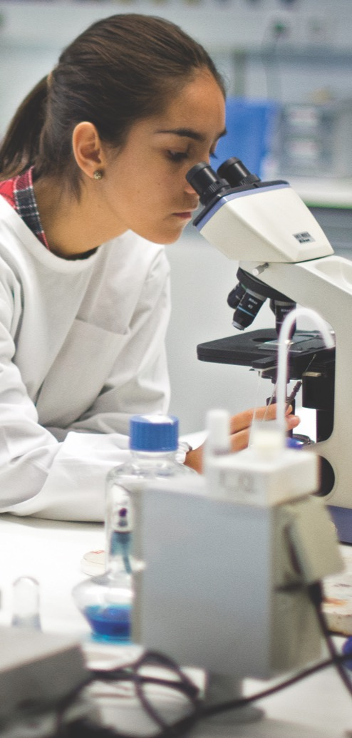
PORTO POLYTECHNIC RESEARCHING AT P.PORTO
RESEARCHING AT P.PORTO
The priority action axis of P.PORTO in R&D aims at generating knowledge to meet society’s great challenges, whether they are of a local, regional or international nature. Our researchers are involved in the latest findings and emerging trends. We bridge senior researchers’ efficiency with young researchers’ audacity. Our culture is based on the deep and constant dialectics between accomplishment and production. We cooperate and lead at national and international level.
Our culture combines leadership with partnership, convergence with diversity, competitiveness with cooperation.
24
Research Centres
692
PhD Researchers
551
ISI Publications

Slide 14

PORTO POLYTECHNIC P.PORTO WORLDWIDE
P.PORTO WORLDWIDE
International cooperation has long been a priority in the institution’s policy. The network, knowledge and information society thrive at P.PORTO and allow students, teachers and researchers to experience the comprehensiveness of resources available globally.
We ranked 6th in Portuguese Higher Education with more international students, and 3rd in mobility programmes for teachers and staff.
183
Incoming Teachers
114
Outgoing Teachers
632
Incoming
Students
351
Outgoing
Students

Slide 15
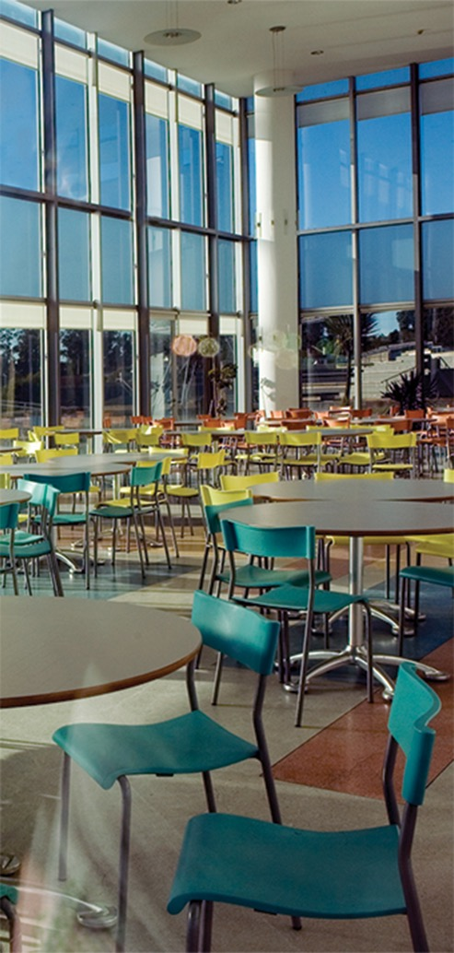
PORTO POLYTECHNIC STUDENT WELFARE SERVICES
STUDENT WELFARE SERVICES
The P.PORTO Student Welfare Services (SAS) operates a strict equal opportunities policy that promotes the success of each student, developing activities and programs that encourage their personal, cultural, scientific, academic and professional fulfillment.
FOOD
SAS guarantees equitable access to meals through its canteens and cafeterias spread across the three campuses.
ACCOMMODATION
In each residence hall, every student finds his special place of comfort and well-being. SAS have several residence halls located in the city of Porto and Vila do Conde.

Slide 16
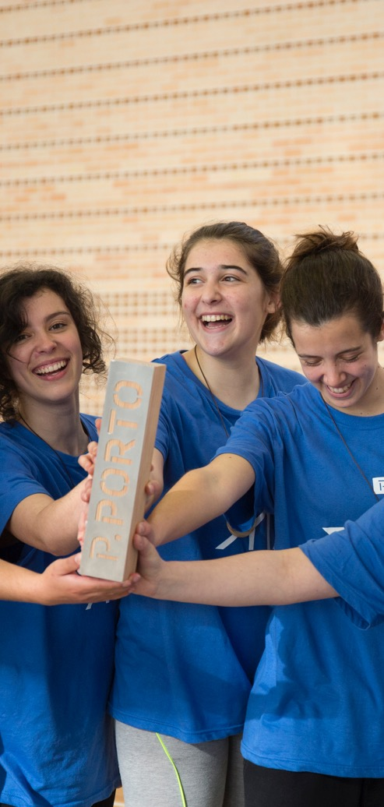
PORTO POLYTECHNIC
STUDENT WELFARE SERVICES
SCHOLARSHIPS AND EMERGENCY AID
SAS promotes a direct social action strategy through scholarships and emergency aid. The granting of scholarships in higher education aims to support one of the noblest principles of our society - equity.
FAES
Fulfilling the mission of an institution that wants to be more inclusive, which emphasizes equal access to quality education, Porto Polytechnic has created a Social Support and Emergency Fund (FAES-P.PORTO), an additional fund to the existing ones, constituted by donations of singular or collective patrons.
FAES-PORTO will allow the institution to implement a "complement" to the social welfare of the State supporting students who, despite the existence of economic needs, do not have access to this welfare.

Slide 17
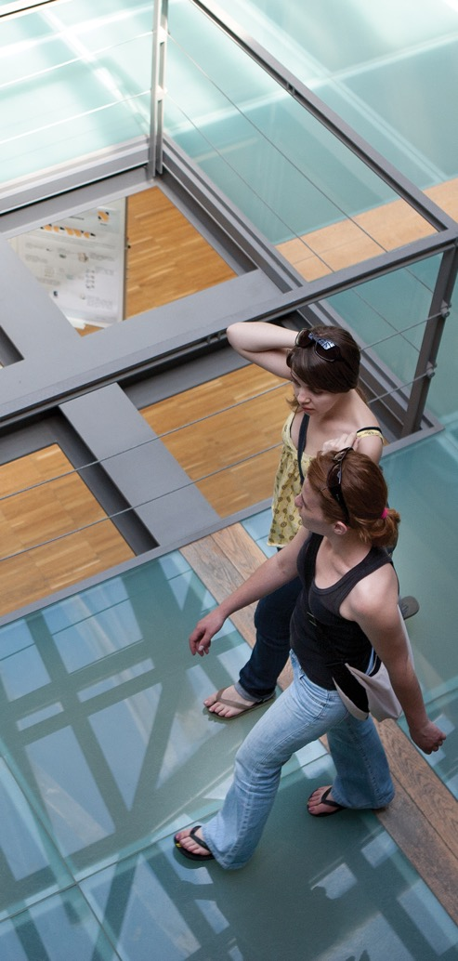
PORTO POLYTECHNIC STUDENT WELFARE SERVICES
RECREATION
SAS encourage a spirit of community, sharing and solidarity, in commitment to the others.
PARTICIPATORY BUDGETING - opAS
SAS Participatory Budget allows any P.PORTO students to be involved dutifully in any activities related to students’ well-being.
9.038.730€
Funding Amount
5.405
Scolarship Holders
319
Single Beds
269.188
Meals

Slide 18
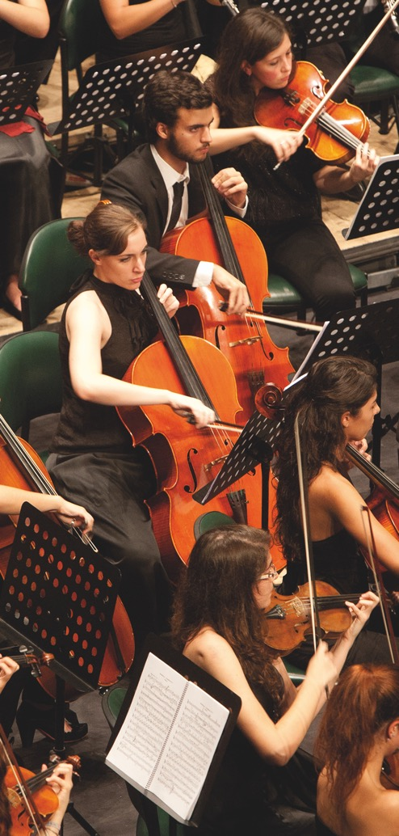
PORTO POLYTECHNIC CULTURE
CULTURE
Striving for excellence in higher education, P.PORTO is committed to being a dynamic agent in the creation, production, dissemination and development of culture, promoting several initiatives of scientific, artistic and cultural nature.
These enterprises involve conferences, exhibitions, thematic workshops, seminars, cinema, journeys and meetings of all kinds, crossing the scientific and pedagogical memory of the first schools with contemporary artistic production.
All these events allow a new generation of skills, a range of new information and sharing ideas, playing a strong role on the formation of global citizens provided with an open culture.

Slide 19
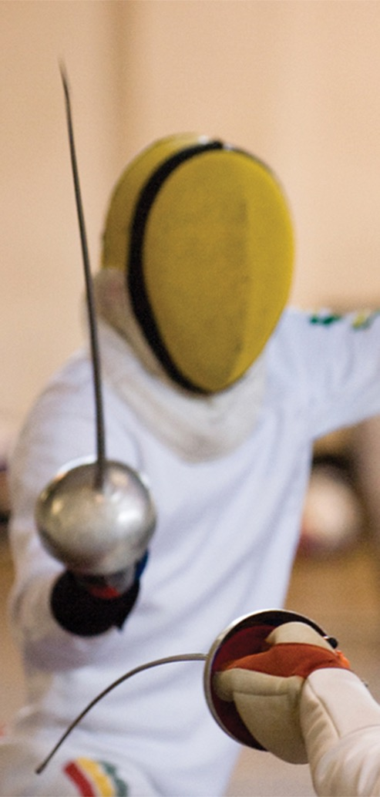
PORTO POLYTECHNIC SPORT
SPORTS
P.PORTO knows how important sports is and how determinant sporting activities may be for students' personal and social development, as well as that of the surrounding communities.
That is why hundreds of students and other people from the surrounding communities are daily involved in different sporting activities carried out in our sports facilities and equipment.
Our Sports Complex offers the academic community high-quality facilities suitable for different types of modalities. P.PORTO Students can also aspire to represent the team in the National University Championships and many other international competitions.

Slide 20
PORTO POLYTECHNIC STUDENT SUPPORT
STUDENT SUPPORT
PSYCHOLOGICAL AND CAREER SERVICES (GIAP)
GIAP aims to provide quality, efficient services to help graduate and current students build skills, improve their well-being and achieve personal and academic success.
Also, our team emphasizes a holistic approach to career and life planning and is committed to empowering individuals to become thriving professionals in the global community, with confidence and competence.
It is a specialized centre and especially dedicated to graduate and current students of P.PORTO.
ACADEMIC ORGANISATION OFFICE (GOA)
GOA is a P.PORTO service aiming at helping students in admission processes, enrolling in courses, creating support groups and assisting in admission processes to higher education.

Slide 21

PORTO POLYTECHNIC STUDENT SUPPORT
MERIT SCOLARSHIP
P.PORTO awards Merit Scholarships annually to the best students of both Graduate and Undergraduate programmes. The scholarships consist of a financial benefit, with a fixed value, and are granted to students with outstanding academic achievement.
STUDENT OMBUDSMAN
The Student Ombudsman defends the rights and ensures the interests of the academic community of P.PORTO by mediating in an independent, impartial and confidential way. Its role is to ensure the legality of the actions carried out by management bodies, services and all those involved in students’ educational process.

Slide 22

PORTO POLYTECHNIC STUDENT SUPPORT
STUDENTS’ UNION
Students’ unions are an open channel for communication, sharing and working, all vital concepts to our mission. The students’ unions play a vital role representing and defending students’ rights with the Schools’ management.
84,5%
Graduates in Employment
or Further Studies
77,2%
Graduates Working
in their Field of Study
1.322
Number of GIAP
Service Users

Slide 23

PORTO POLYTECHNIC
PRESIDENCY
A RUA DR. ROBERTO FRIAS, 712
4200-465 PORTO, PORTUGAL
T 225 571 000 F 225 020 772
E IPP@IPP.PT W IPP.PT

